Slide 1
Effects of Security Measures on School Personnel
Cora S. Graves, JD, Ed.S.
Notes:
Good afternoon, I am Cora Graves. I currently serve as a school Assistant Principal in the northern suburbs of Atlanta. I have worked in education for nearly 20 years in various role but significantly as a School Social Worker, Disciplinary Hearing Officer, School Court Related Collaborative Coordinator, PBIS District Coordinator, and Assistant Director of Student Discipline and Behavioral Interventions. I have also had the privilege of serving as a law clerk for Chief Juvenile Judge Steve Teske in Clayton County Juvenile Court for which I had the awesome opportunity to directly experience the impact of collaboration amongst key stakeholders to impact positive change for students. I am thrilled to be here as the topic is one that I am passionate about and have lived the journey since 2000 beginning in Chicago Public Schools.

Slide 2
Historical Glimpse at School Shootings
1999: Columbine Shooting
2001: C. Anderson Middle School Dallas, Tx
2006: West Nickel Amish Mines School, PA
2007: Virginia Tech, Blacksburg, VA
2008: Northern Illinois University, Dekalb, IL
2012: Sandy Hook Elementary
2018: Parkland, Florida
Notes:
Quickly, schools in America have been negatively impacted by violent gun shootings in some form which precipitated the increase in school police officer presence.

Slide 3
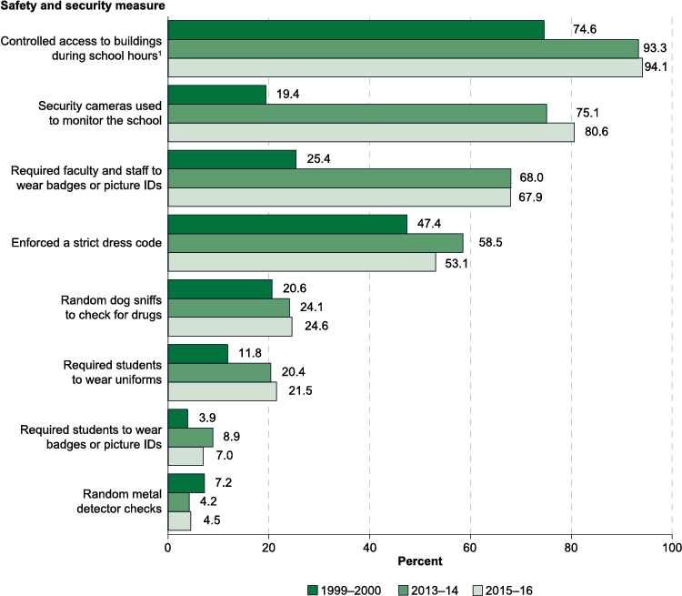
School Security Responses
Notes:
Webster defines security as something that secures : PROTECTION
b(1): measures taken to guard against espionage or sabotage, crime, attack, or escape
“…..If I were to ask you all how you define school security, I am certain that there would be varying definitions within this room. From my research, school districts across the country vary in how they define increasing school safety. As such, there are school systems such as Chicago Public Schools that utilize metal detectors versus Clayton County Public Schools in the southern portion of the state of Georgia that along with other states that would not even so much as consider metal detectors.
The Code of Conduct for school systems

Slide 4
2014 Dear Colleague Letter
Student Code of Conduct
Effective School Discipline
Redress Racial Discrimination in School Discipline
Title IV and Title VI
Disparate Treatment
Disproportionate Discipline
Notes:
January 8, 2014, a joint effort between the Department of Justice and the Department Education wrote the January 8, 2014 DCL in an effort to ………

Slide 5
If not Zero Tolerance, then what?
School Resource Officer
School Superintendent
I received multiple phone calls after the Parkland shooting from parents that wanted to know how I planned to make sure the school would be safe. I believe that school safety is a team effort so I am not alone in securing the school. Being highly visible, relationship with students, and layered team effort of AP, SRO, and Campus Monitors are the main ingredients.
Having a police officer, an office of the court at ready access minimizes fear and concern regarding the safeness of the school environment. One area of concern is the overuse of the SRO for matters that are the responsibility of school administrators. The line of authority must be clearly drawn. The SRO should be engaged in matters that have legal implications or recourse.
Notes:
“This federal law (Goss v. Lopez) must be included in any student discipline code. A student should also have the right to appeal any suspension of three days or more to the principal or a district-level staff member.” “The principal, not the school resource officer, should set the tone for creating the school’s environment for teaching and learning” (Dr. Jim Taylor).

Slide 6
Keeping Students In School and Out of Court
Zero Tolerance Policies
Court Related Collaboration
School Justice Partnerships

Slide 7
Effective Security Measures
Increase in School Connectedness
Increase training of SRO for Safety & Criminal Matters
Increase Student Service Coordination
Increase awareness for social emotional learning
Increase School Justice Partnership
Notes:
Finally, evidence based practices that should be implemented by schools include but are certainly not limited to increasing school connectedness…(school personnel would be benefit most from building relationships with students to encourage them to attend school). Clear distinction should be made between

